Slide 1

Game Data Analytics Project 1
Evelyn (Wanyi) Dong Jenny Shang
Matt Andersen

Slide 2

Sales Data Analysis

Slide 3
Our Objective
$
Optimize Monetization
Increase Engagement

Slide 4
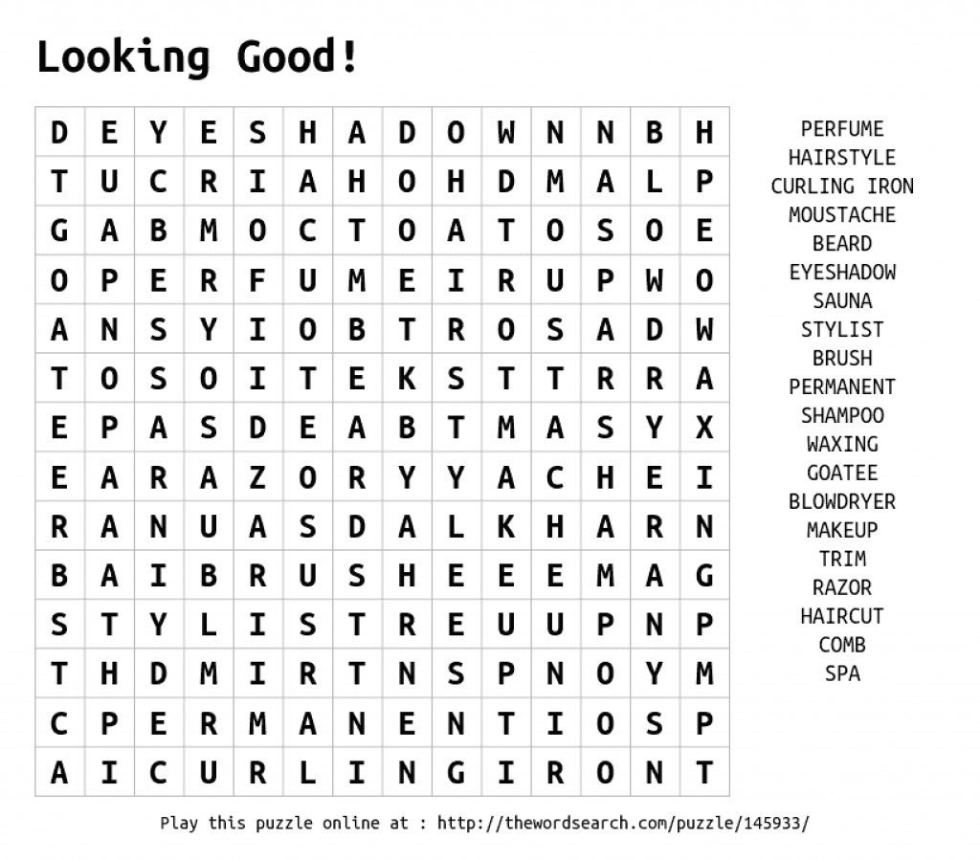

Recommendation 1 (A-level)
Narrow the Focus of the Targeted Marketing Efforts
Fact #01
Highly educated users tend to spend more
Seek out mobile games or web-based games with most highly valued cohort of players
Fact #02
Most of our users are aged 50 or older
Fact #03
Female users remained subscribed slightly longer than male users
Place ads on websites that receive a high amount of traffic from this targeted demographic

Slide 5
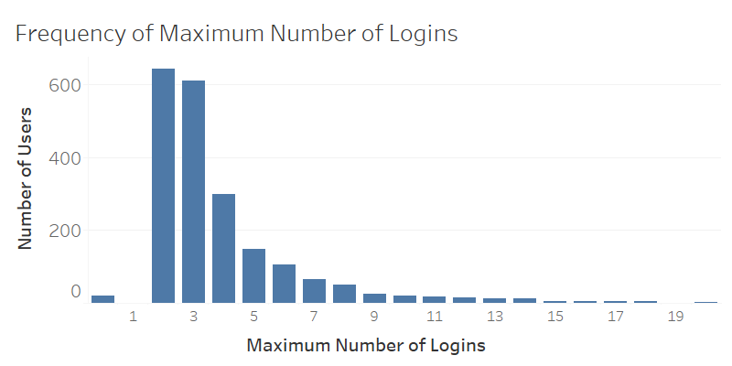


Recommendation 2 (A-level)
Incentivize Users to Increase Engagement and Activity
Long-term engagement
is very important for subscription-based games
Most users only log in no more than 3 times
Introduce features to incentivize logins

Slide 6
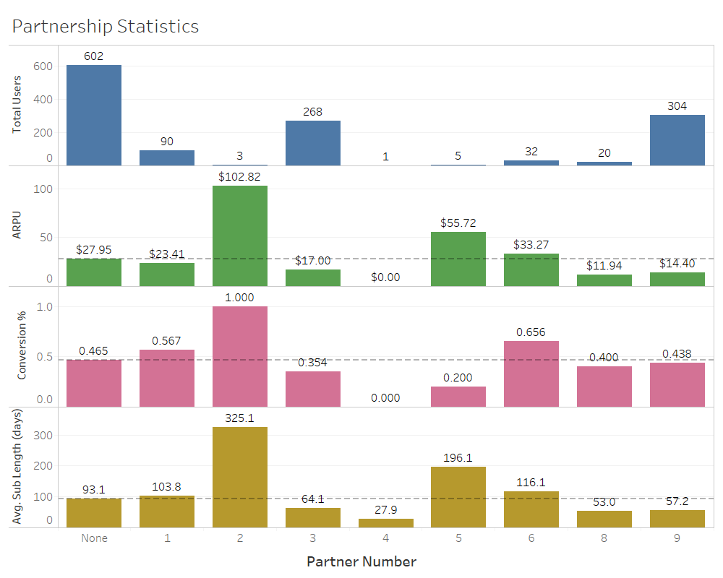
Recommendation 3 (B-level)
Re-allocate resources toward the highest performing partnerships
End relationships with low-value partners
Prioritize high performing ones
3, 9
2, 5, 6

Slide 7

Sudoku Data Analysis

Slide 8
Two Key Questions
Who are the most valuable sudoku players we want to solicit and retain?
How can we attract and engage more of these high-value players?

Slide 9
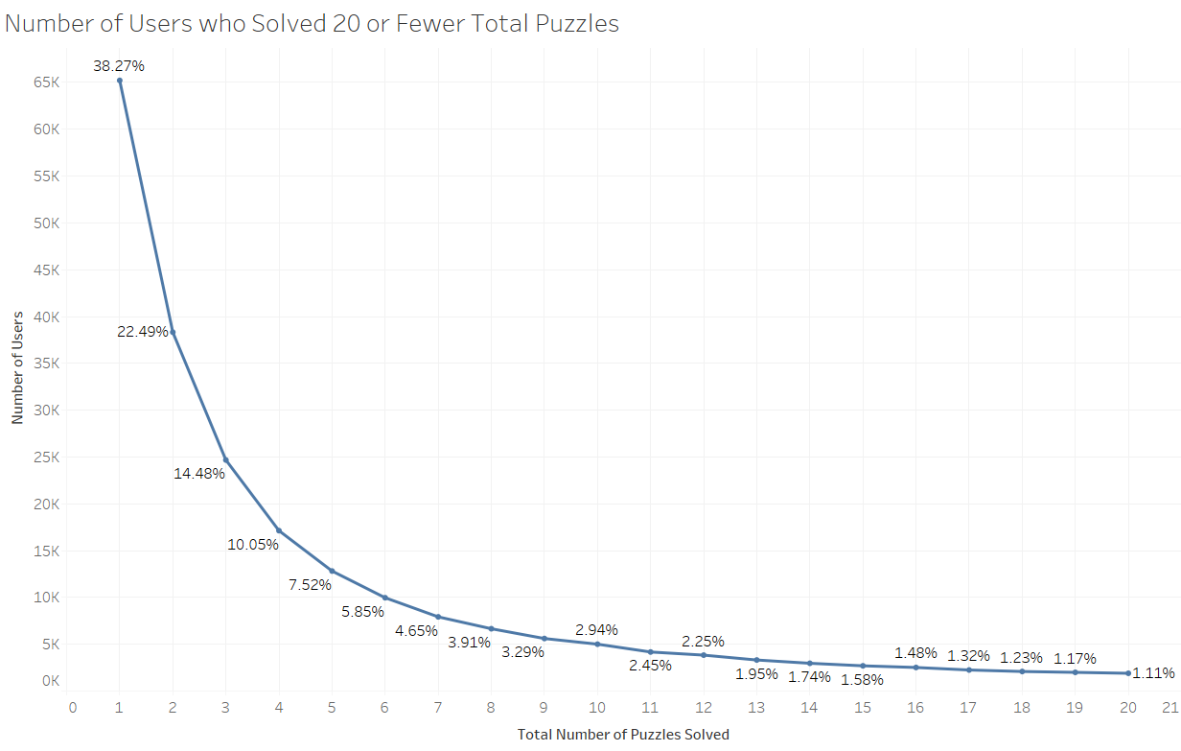
Recommendation 1 (A-level)
Focus on Repeat Engagement of Existing Users
Introduce email campaigns
Introduce reward system
based on level
Most users only solve 2-3 puzzles
Add features to motivate players

Slide 10
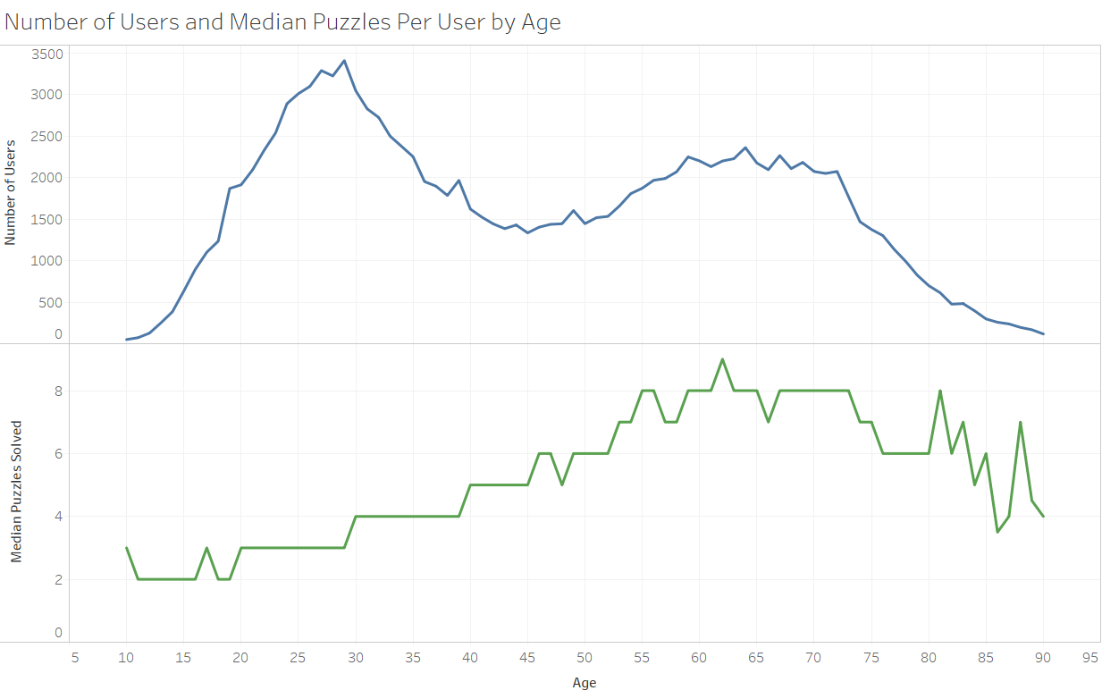
Recommendation 2 (A-level)
Target International Users
& Users in the 33~55 Year-Old Age Range
Although this game is most popular among people aged 25 ...
Support additional languages
Tailored Marketing
… older users solve more puzzles on average

Slide 11
Recommendation 3 (B-level)
Increase incentivization for new users to register for accounts
27%
did not populate any optional fields
Increase features that are only accessible to registered users
Highlight advantages for registering an account

Slide 12
Q & A

